Slide 1

Random Number Generators
Cryptographic Secure Random (CSPRNG)

Slide 2
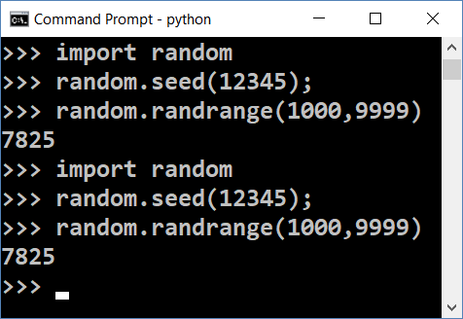
Random Generators and Cryptography
In computer science random numbers come from a pseudo-random number generator (PRNG)
Consists of initial entropy (seed) + pseudo-random function
To be secure, a PRNG should start by a truly random initial seed
Known seed generates predictable random numbers → insecure
! insecure !
Insecure randomness can compromise cryptography
The stolen Bitcoins story: https://goo.gl/PFE1kr

Slide 3
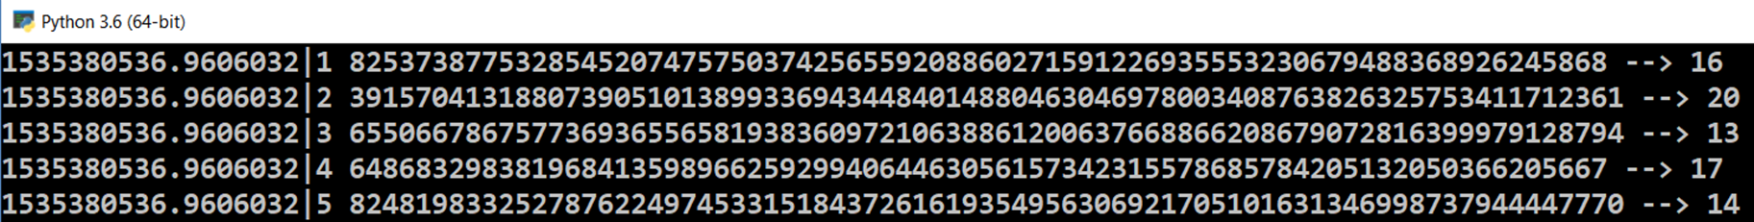
Creating a Pseudo-Random Generator in Python
import hashlib, time
startSeed = str(time.time()) + '|'
min = 10, max = 20
for i in range(30):
nextSeed = startSeed + str(i)
hash = hashlib.sha256(nextSeed.encode('ascii')).digest()
bigRand = int.from_bytes(hash, 'big')
rand = min + bigRand % (max – min + 1)
print(nextSeed, bigRand, '-->', rand)

Slide 4
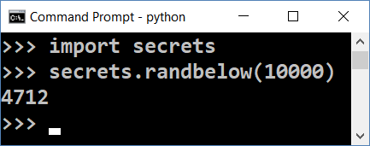
Secure Random Generators (CSPRNG)
Cryptography secure random generators (CSPRNG) guarantee that the random numbers are absolutely unpredictable
E.g. hardware devices (TRNG) capturing physical processes
CSPRNG should start from a truly random seed
Modern OS collect entropy (seed) from keyboard clicks, mouse moves, network activity, etc.
Accessible from /dev/random and /dev/urandom
In Python use the secrets library

Slide 5

Random Number Generators
Try the Code!

